Slide 1
NBA BETTING
A QUANTSC PROJECT
Jonathan Qin, Zayn Siddique, Rithik Pothuganti, Roy Hayyat, Claude (Hana) Yoo

Slide 2
TABLE OF CONTENTS
01
03
02
04
MOTIVATION
DATA + MODELS
Why bet on the NBA?
Data collection, features, techniques & results
BACKGROUND
CONCLUSIONS
Basketball talk and betting processes.
Evaluation and looking ahead.

Slide 3
01
MOTIVATION

Slide 4
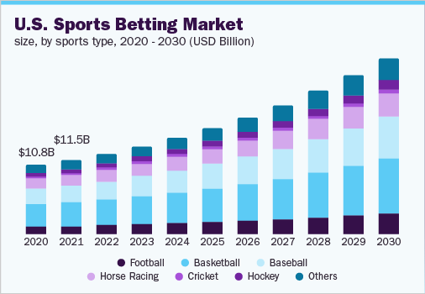
MOTIVATION
Why sports betting?
83.65 billion USD global market in 2022
10.3% CAGR until 2030
Increased online betting
Largely uninformed bettors
In the US, basketball has the largest betting market
Here you give a brief intro of the topic you want to talk about. For example, you can talk about Mercury
Notes:
CAGR = compound annual growth rate
https://www.grandviewresearch.com/industry-analysis/sports-betting-market-report

Slide 5
MOTIVATION
Why the NBA?
Basketball is the most rapidly evolving sport in the top 5 American leagues. In the last 10 years, the sport has changed more than it ever has, and data has been behind that much of that change. We wanted to see what metrics help teams win the most basketball games.

Slide 6
02
BACKGROUND

Slide 7
BACKGROUND
How does basketball work?
Basketball is played with 2 teams of 5 players each.
Each team can score with a 1, 2, or 3 point shot.
The team with the most points after time is up is the winner.
Here you give a brief intro of the topic you want to talk about. For example, you can talk about Mercury

Slide 8
Basketball Terminology
Points
Weighted total of all free throws(1 point), 2-pointers, and 3-pointers
Rebound
Grabbing the ball after a missed shot to start a new possession
Assist
Leading pass that directly leads to a made shot
Block
Deflection of a shot
Steal
Deflection of a pass or taking the ball from the ball-handler resulting in change of possession

Slide 9
Basketball Terminology
STAT%
Can be applied to counting stats (AST%, STL%)
Measures the percentage of the available stat the player performs
FG%
Shots made/Shots taken as a percentage
eFG/TS%
Modified FG% to weight shots by value
ORTG/DRTG
Points produced/allowed per 100 possessions
USG%
Weighted percentage of possessions that end in a player’s hands
BPM(Box +/-):
Difference between points scored and points given up

Slide 10
NBA Sports Betting Rundown
Odds and Betting Lines
Odds can be positive and negative.
Negative odds tell you how much you have to bet to win $100 in profit
Positive odds tell you how much profit you win for every $100 you bet

Slide 11
Types of Bets
Moneyline
Point Spread
Betting on the margin of points.
GSW +2.5 OKC –2.5
The underdog can lose by and still cover the spread. Ex: OKC have to not lose by 3 or more points to cover the spread.
The favorite must win by in order to cover the spread. Ex: GSW have to win by 3 or more points to cover the spread.
A straight up bet on which team is going to win the game.
GSW –200 OKC +180
Over / Under
Predicting whether the total points scored by both teams combined will be over or under a set total by a sports book.
GSW vs OKC: 210.5
Notes:
Moneyline: includes overtime
Over/Under: includes overtime (unless specified)
Point Spread: Includes overtime (unless specified)

Slide 12
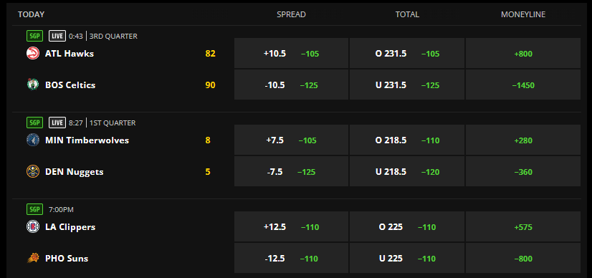

Slide 13
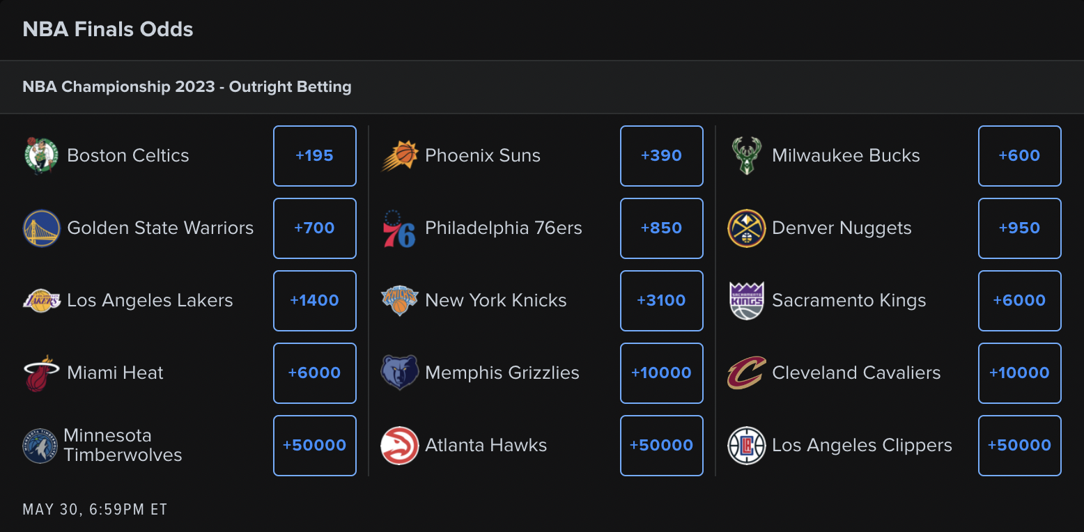

Slide 14
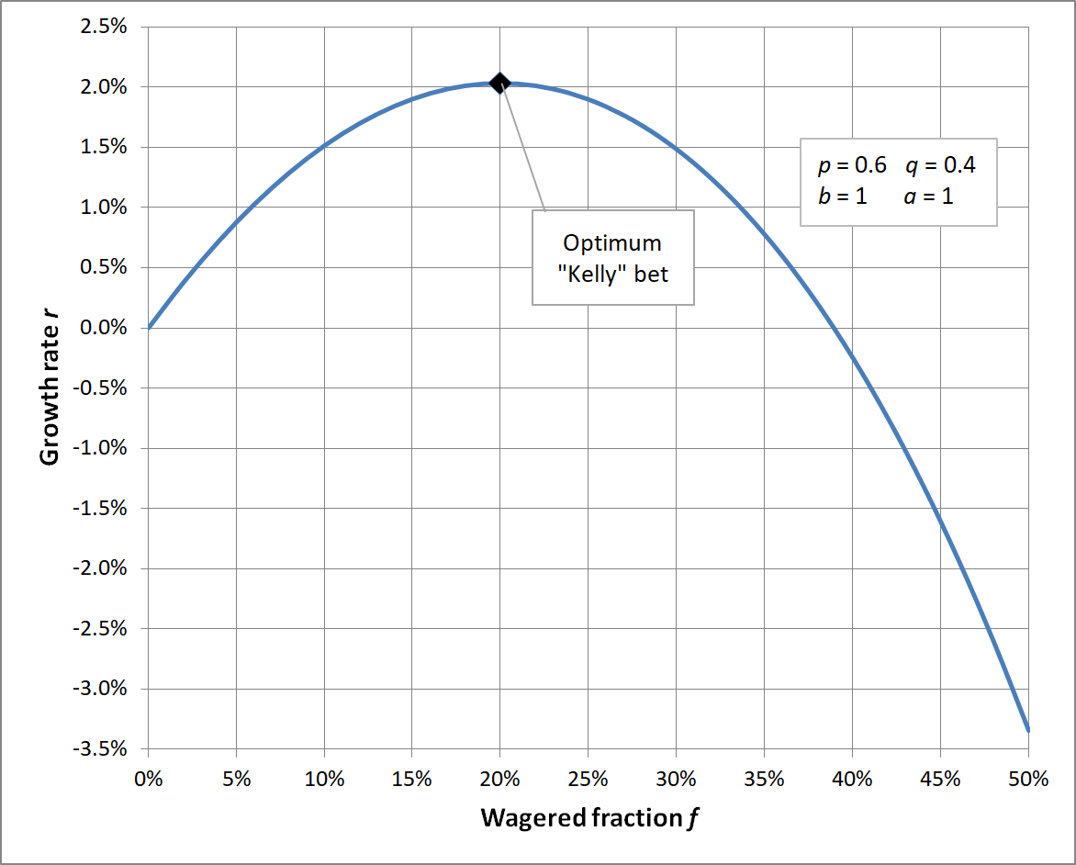
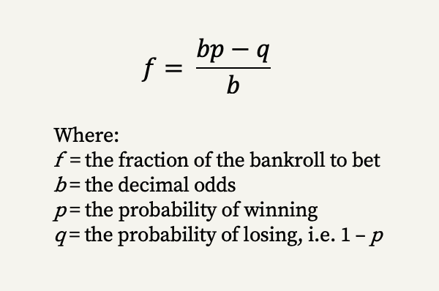
Kelly Criterion
Probability theory - method for sizing up bets, used for determining how much of a predetermined asset to allocate to a bet, ensuring greatest chance of success.
Takes into account the probability of winning/losing a bet, as well as the amount associated.
The criterion suggests that the optimal size of a bet is equal to the percentage advantage f multiplied by the available capital.
Here, the decimal odds b represents the amount one wins for every $1 wagered.
Notes:
Potentially can mention that we look to further modify this model to reduce volatility and risk (just haven’t gotten to that yet).

Slide 15
03
DATA

Slide 16
Data Collection
Data collected from Basketball Reference
Scraped off of the website’s tables using the BeautifulSoup library for Python
Collected regular season/playoff data from 2015-2023
Collected aggregate season data from 2002-20022
Data includes
Team standings
Team stats
Player counting/advanced statistics
Other miscellaneous data

Slide 17
Models
Neural Network
3 layer network
K Nearest Neighbors
Similar teams win every year?
Random Forest Regressor
Predictions without overfitting

Slide 18
Features
Used NBA data from 2002-2022
Advanced Stats
TS%, TOV%, FT rate, 3PA rate, Offensive rating, Defensive rating
Conventional Stats/ratios
Wins, Losses, Free throw/Field Goal ratio, rebound percentage
Miscellaneous metrics
Attendance/tickets sold, age

Slide 19
K Nearest Neighbors
Used 100 nearest neighbors
Teams with similar play-styles tend to win
Metrics
Mean Squared Error: 11.900
R-squared: 0.577
Predictions
BOS_2023: 6.67
CLE_2023: 6.53
PHI_2023: 4.47
MEM_2023: 4.74
MIL_2023: 5.48
DEN_2023: 4.62
NYK_2023: 3.05
SAC_2023: 3.13
PHO_2023: 2.34
GSW_2023: 2.01
BRK_2023: 1.66
LAL_2023: 1.48
LAC_2023: 1.82
ATL_2023: 0.85
MIN_2023: 0.99
MIA_2023: 1.19

Slide 20
Neural Network Predictor
Architecture
3 Relu Activation layers
3 Hidden layers
3 Fully connected layers
3 Batch normalization layers
3 Dropout layers
Metrics
Loss: 6.1753
R-squared value: 0.6809
Predictions
BOS_2023: 8.318
CLE_2023: 6.412
PHI_2023: 6.488
MEM_2023: 4.865
MIL_2023: 6.685
DEN_2023: 5.819
NYK_2023: 3.034
SAC_2023: 4.410
PHO_2023: 1.680
GSW_2023: 2.267
BRK_2023: 0.884
LAL_2023: 0.718
LAC_2023: 2.173
ATL_2023: -0.184
MIN_2023: -0.080
MIA_2023: 1.733

Slide 21
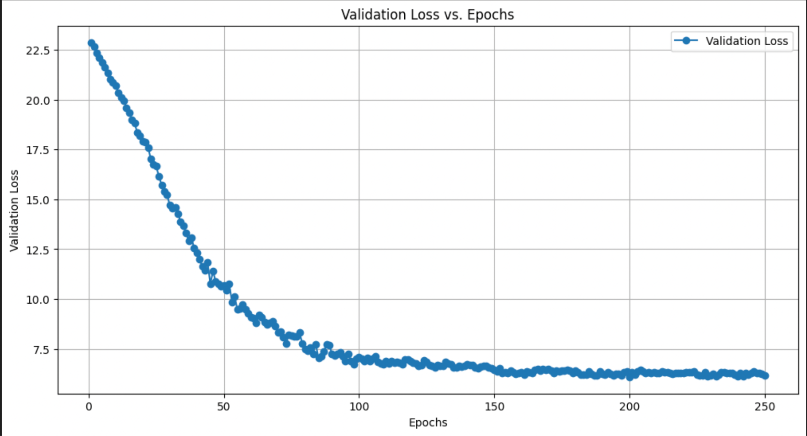

Slide 22
Random Forest Regressor
Ensemble of decision trees
Max depth of 10
100 trees in forest
Metrics
Mean Squared Error: 5.270
R-squared: 0.726
Predictions
BOS_2023: 10.88
CLE_2023: 6.90
PHI_2023: 7.69
MEM_2023: 6.64
MIL_2023: 8.06
DEN_2023: 8.88
NYK_2023: 2.19
SAC_2023: 4.06
PHO_2023: 0.54
GSW_2023: 2.35
BRK_2023: 3.13
LAL_2023: 1.04
LAC_2023: 3.03
ATL_2023: 0.56
MIN_2023: 1.79
MIA_2023: 2.10

Slide 23
04
CONCLUSIONS

Slide 24
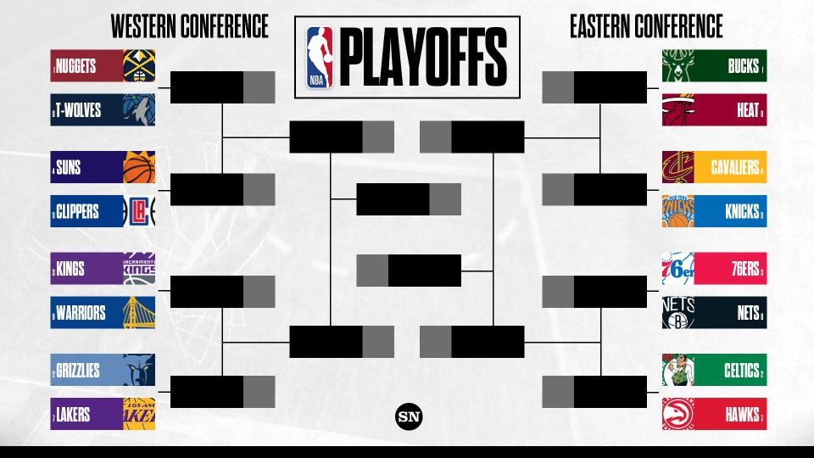

2023 Playoff Predictions
Nuggets
Bucks
Nuggets
Bucks
Suns
Cavaliers
Nuggets
Celtics
Kings
76ers
Grizzlies
Celtics
Grizzlies
Celtics

Slide 25
Drawbacks of models/features
Does not consider trades
Has no info about injuries
Does not factor past playoff performances into predictions
“Playoff Performers”
Does not make game-to-game predictions, so less opportunities to place bets
Looking Forward:
Regular Season betting
more predictable
Live betting

Slide 26
THANK YOU

